Slide 1
Introduction
- SQL databases use structured query language (SQL) and have a predefined schema.
- NoSQL databases have dynamic schemas for unstructured data.
- SQL databases are a good option for applications structured around relationships between data tables, ensuring data consistency across tables.
- NoSQL databases provide more flexibility and scalability but offer less control over consistency and data relationships.

Slide 2
- MongoDB is a popular NoSQL database.
- It uses flexible schemas for unstructured data storage.
- MongoDB Atlas is a fully managed, global database service that offers a generous, forever-free tier for users to try NoSQL databases.

Slide 3
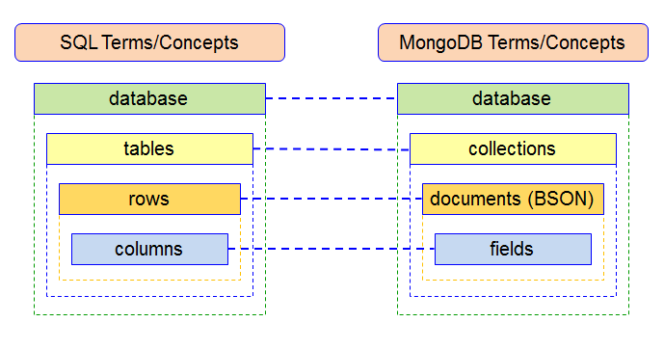

Slide 4
- SQL is a widely used language for relational databases.
- Relational databases are a good choice for applications structured around relationships between data tables.
- SQL ensures data consistency across tables.
- SQL databases provide a structured approach to data management.

Slide 5
Comparison
- **Schema**: SQL databases have a predefined schema, while NoSQL databases have dynamic schemas.
- **Flexibility**: NoSQL databases offer more flexibility in terms of data structure and schema changes.
- **Scalability**: NoSQL databases are highly scalable and can handle large amounts of data.
- **Consistency**: SQL databases provide strong consistency, while NoSQL databases offer eventual consistency.
- **Query Language**: SQL databases use SQL as the query language, while NoSQL databases use various query languages or APIs.

Slide 6
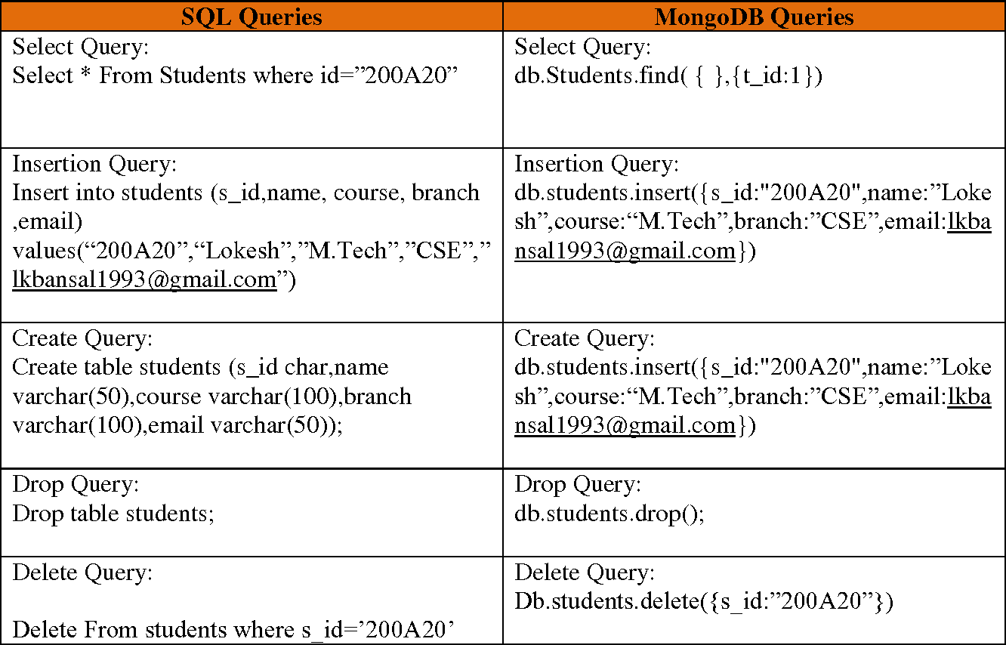
Exemple

Slide 7
Use Cases
- SQL databases are suitable for applications that require strict data consistency and structured data management, such as financial systems or e-commerce platforms.
- NoSQL databases are ideal for applications that handle large amounts of unstructured or semi-structured data, such as social media platforms or real-time analytics systems.
- The choice between SQL and NoSQL depends on the specific requirements of the application and the nature of the data being stored.
**Note**: This presentation provides a high-level overview of MongoDB and SQL databases. For more in-depth information, additional research is recommended.

Slide 8
In conclusion, both MySQL and MongoDB have their unique strengths, and your choice of database should align with your application’s needs and the type of workload it handles. Consider the trade-offs in terms of consistency, availability, concurrency control, and overhead while making your choice.

